Slide 1
Introduction to Lockpicking
By Jeff Toth

Slide 2
[root@disillusion.us ~]$ whoami
Information security “professional” for over 6 years
Professional hobbyist in lock picking and physical security
Loves long walks barefoot on the beach
@geekevolved
http://disillusion.us

Slide 3
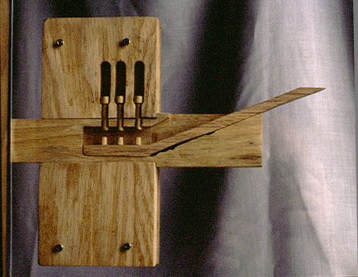
Ancient Egyptians Invented Modern Lock Design

Slide 4
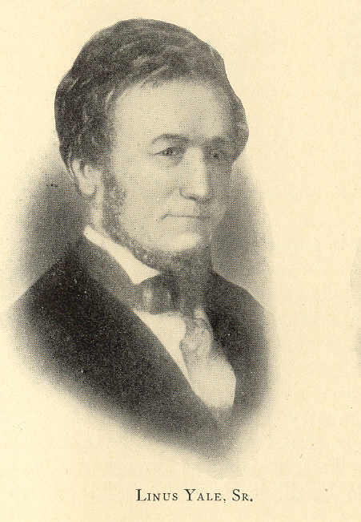
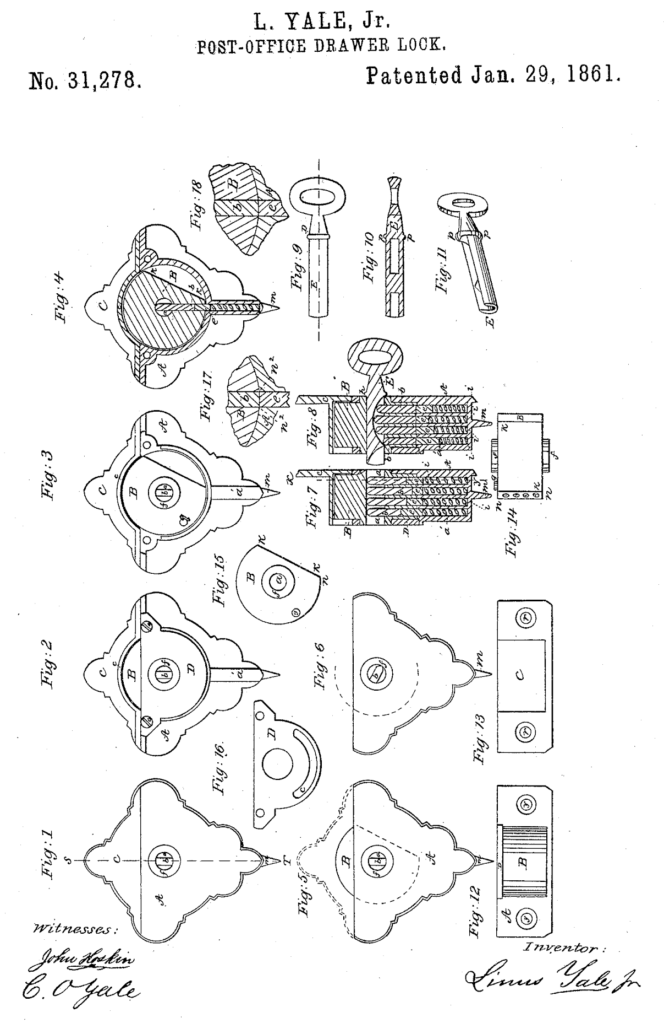
This guy brought it to modern time

Slide 5
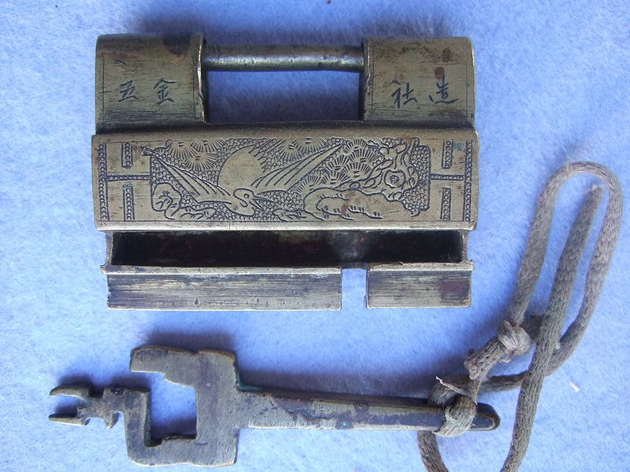
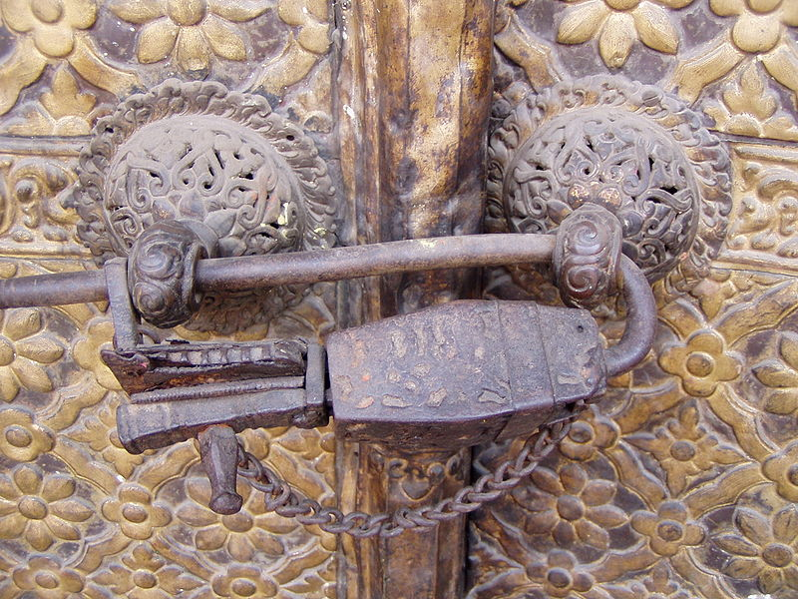
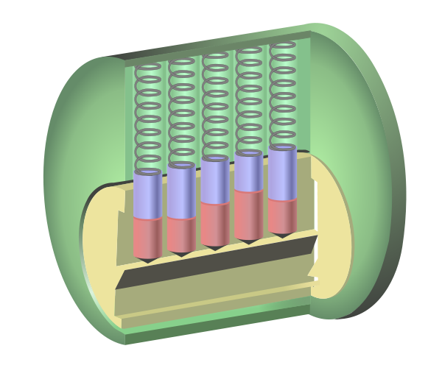
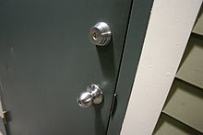
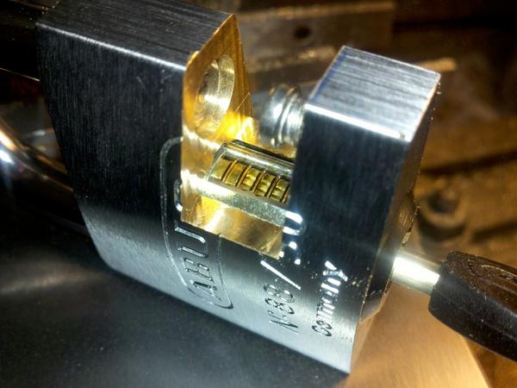

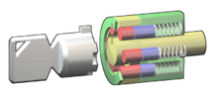
Chinese warded lock.
Yunnan Province early 20th century
Medieval Nepalese Lock
Abloy or Disc Tumbler Lock
Modern Pin Tumbler Locks

Slide 6
Isn’t it illegal?
Short answer: no
Long answer: noooooooooo
Longer answer: In Florida, it is legal to possess “burglary tools”, provided the intent of the person is to not commit a crime. There are some counties that restrict usage, such as Miami-Dade
Florida Statutes - § 810.06 - Possession of burglary tools. Whoever has in his or her possession any tool, machine, or implement with intent to use the same, or allow the same to be used, to commit any burglary or trespass shall be guilty of a felony ….
If you are caught committing a crime and have burglary tools on you, then you face a felony charge.
Other states vary, so check http://toool.us/laws.html for laws by state.
Notes:
I have not actually confirmed the legality of “burglary tools” in Miami-Dade as of yet, but I have had a number of people tell me that specifically.

Slide 7
Is this ethical?
Yes, it is. In reality, a criminal would never use a lockpick or bypass tools to commit a crime. It’s more likely that they would use destructive entry to achieve their goals.
“With great power comes great responsibility”
-Uncle Ben, Spiderman
It used to be easier to bypass security mechanisms for the average crook (re: slimjim), but the level of skill required causes the barrier of entry to be higher. Time vs level of effort tradeoff

Slide 8
A couple of ground rules
We’re all hobbyists here and we should follow a few rules here to stay out of trouble:
Only pick locks you own or have the express permission to pick. (ethics, remember?)
Do not pick locks you rely on i.e. your home’s doors, car doors, garage doors, safes with important documents, etc
Locks can be broken and the risk is higher when you are first starting out. This is common sense, but the amount of internet posts where someone damages their front door locks and has to call a locksmith is astounding.
This rule can be broken eventually, but I don’t recommend it until you are able to pick locks without thinking about it.
Notes:
Do as I say, not as I do.

Slide 9
So why learn lockpicking?
It’s fun!
It’s a great hobby to help take your mind off of work. It’s a competition with friends!
It’s also a helpful skill as a security professional.

Slide 10
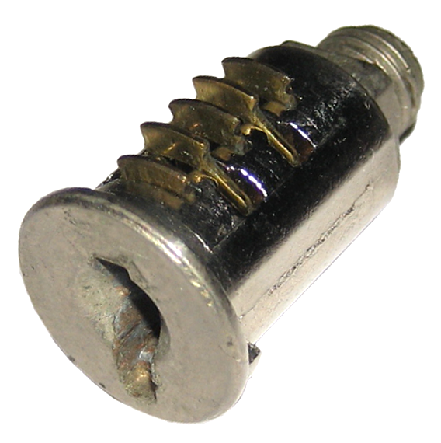
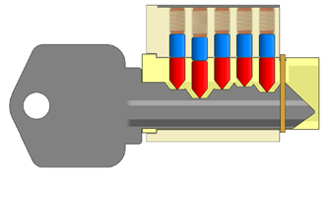
Modern locks
Two of the most common locks you’ll see today are the wafer lock (found in filing cabinets mostly or advanced versions in cars) and the pin tumbler (basically every other lock that isn’t a wafer.

Slide 11
Why is this possible?
After hundreds of years, you’d think we’d be able to come up with the most secure lock in the world, right?
Highly secure locks are expensive, who wants to spend more money on better locks when the average lock works just fine?
The motivation for companies to develop the perfect lock is just not there. And when they think they do, smart people figure out how to bypass it. (re: Medeco)
Locks are security theater.

Slide 12

Didn’t the Egyptians invent this lock type?!

Slide 13
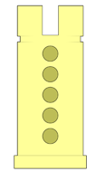
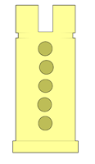
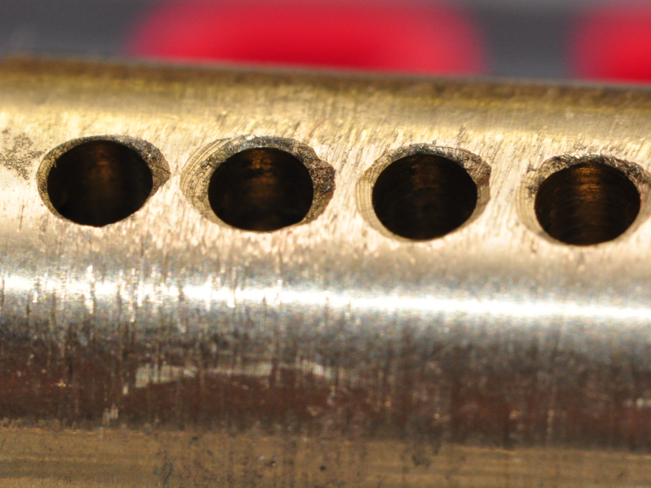
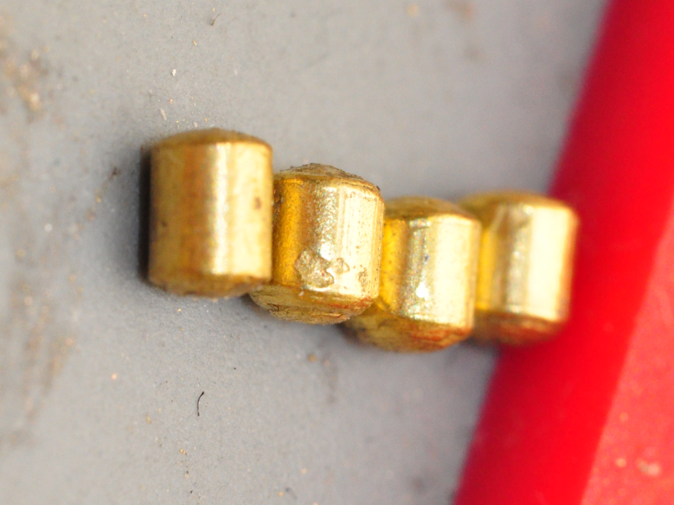
Why is this possible? pt2
In a perfect world, the lock manufacturing would be perfect. The drilled holes lined up exactly, all the pins would bind at the same time and everything would look perfect.
In reality though…

Slide 14
Pin tumbler normal use

Slide 15
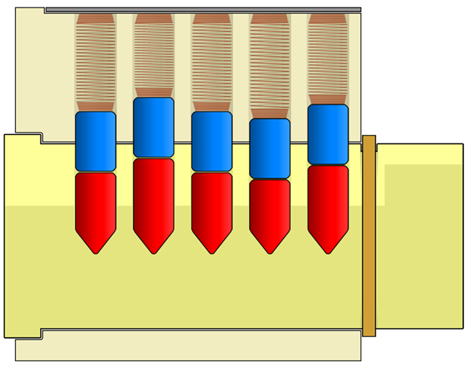
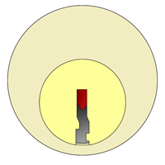
Parts of a pin tumbler lock
Shear line
Spring
Shear line
Driver Pin
Key Pin
Keyway
Notes:
The goal here is to push the driver pin past the shear line without binding the key pin. A tension wrench provides tension to capture the driver pin to keep the driver pin in place. Manipulate the key pin, which pushes the driver pin above the shear line. After all pins are in place, the lock opens

Slide 16
Pin tumbler being picked
Notes:
You can see in this animation, two tools, the first, being inserted into the bottom of the lock, or the keyway. That tool is called a tensioner (or also known as a tension wrench). This applies tension on the lock to keep the driver pins (blue pin) above the shear line. Too much tension and you will bind the key pin (red pin) above the shear line.

Slide 17
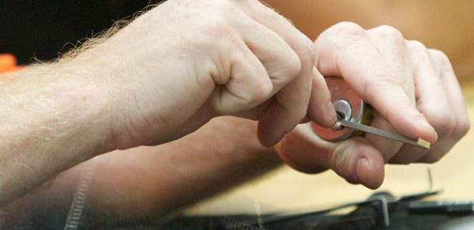
How do I hold it?

Slide 18
What’s raking and bump keys?
Raking a lock or using bump keys are similar methods of opening a lock without a key. Raking and bumping is more violent and has greater chance of breaking a lock if you don’t know what you are doing. I don’t demonstrate or make the tools available for that reason.
Notes:
10-15 minutes for this part, you can play with the locks while I talk, or wait till we’re done.

Slide 19
Raking

Slide 20
Bump Keys

Slide 21
Pick gun
Notes:
10-15 minutes for this part, you can play with the locks while I talk, or wait till we’re done.

Slide 22
Now what?
So this is your basic lock, but what else is there?
Notes:
10-15 minutes for this part, you can play with the locks while I talk, or wait till we’re done.

Slide 23
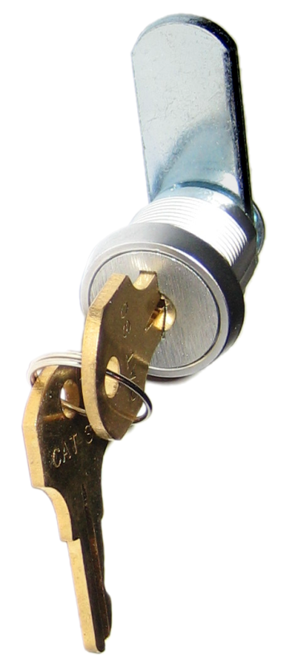
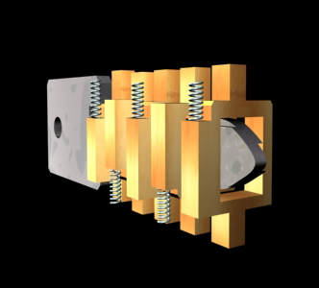
Wafer Locks
These types of locks are typically found on office desks or filing cabinets. They are also found in your car locks and ignition. However, they are low security locks. Cars are easy to pick into, however, these locks are also easy to break, so it’s hard to practice.

Slide 24
Wafer Locks in Action

Slide 25
How do I do this?
Picking simple wafer locks work in the same way that pin tumblers do, except ridiculously. You apply tension on the lock, and you push each wafer into the center position as seen on the previous animation.

Slide 26
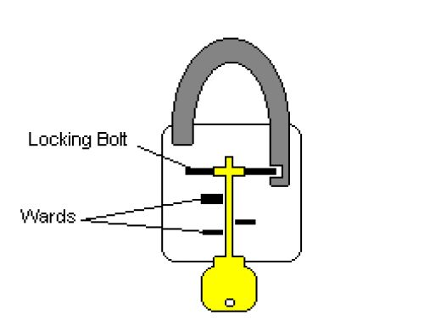
Warded Locks
Warded locks are an older design of a lock. They are incredibly simple to open. The goal was that there would be wards that would block the unlocking mechanism from being picked. However, you can make a warded lockpick out of a warded key, and that’s where the term “skeleton key” originally came from.
I have a few out on the table if you want to play with them. These can be opened very easily with a hook pick in a matter of seconds.

Slide 27
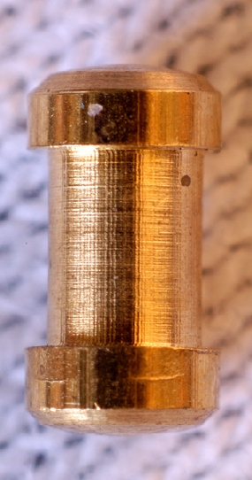
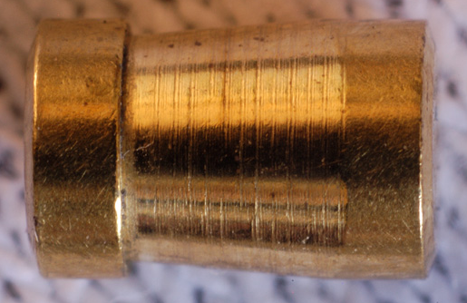
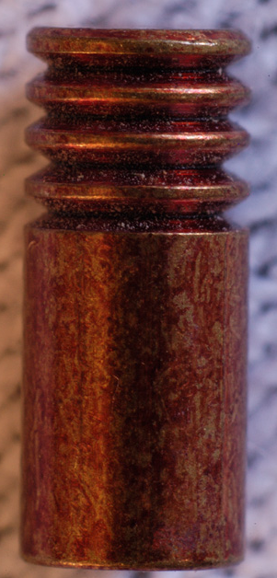
Security pins
Now that we’ve gone over most of the basic lock types and how to open t hem, we’re going to revisit the pin tumbler and some of the security pins that are put into place to make it more difficult to pick them

Slide 28
Spool Pin
Shaped like a spool. To bypass a lock with a spool pin, and any security pin, you need to be able to manage tension really well.

Slide 29
Mushroom Pin
Similar to a spool pin, but simplier.

Slide 30
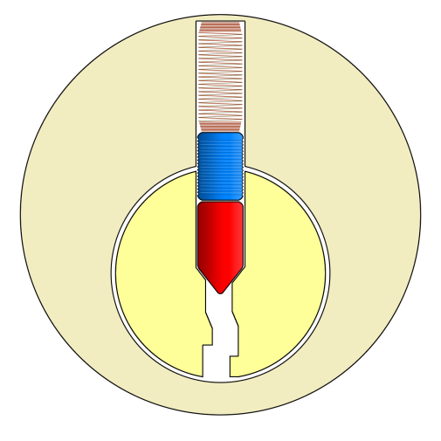
Serrated pin
This is defeated the same way as the last two, but requires a lot more time and patience. The picture shown is one configuration of serrated pins. I unfortunately do not have an animation of this, just a still picture.

Slide 31
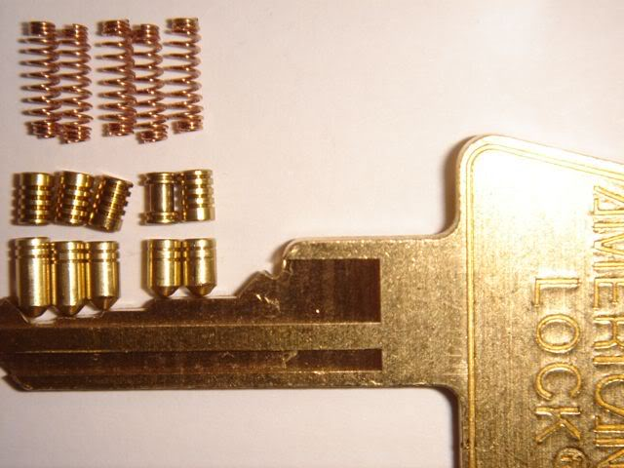
Or some combination

Slide 32
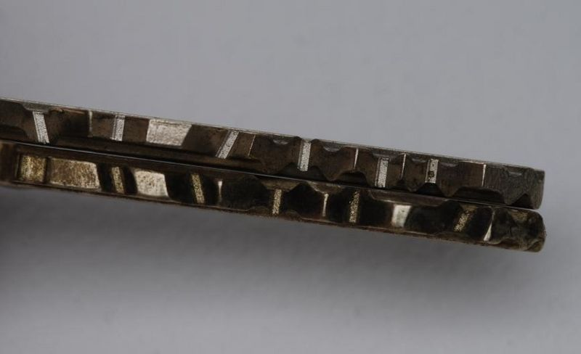
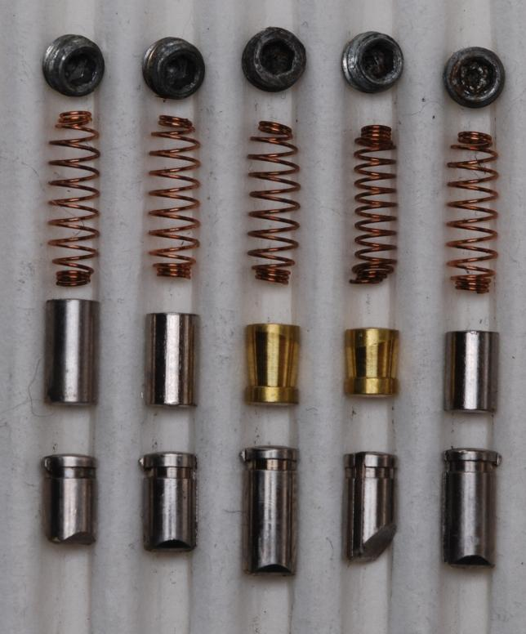
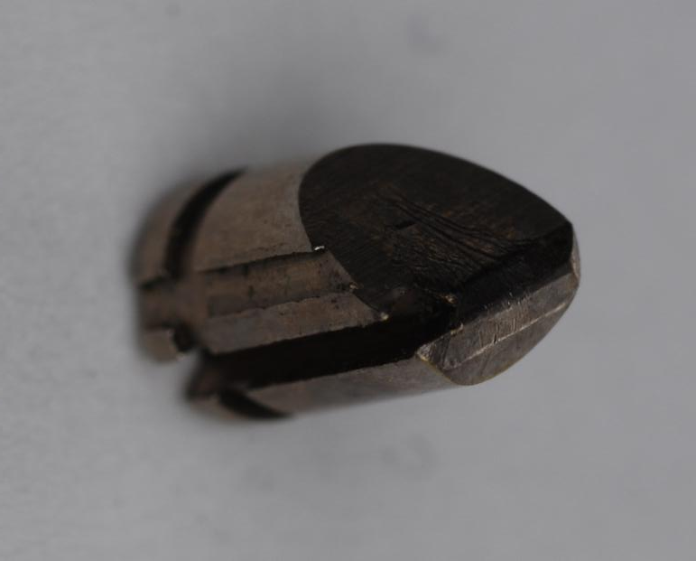
Biaxial locks

Slide 33
Lock Bypasses
In addition to picking locks, a number of locks have the ability to bypass the locking mechanism all together.
A number of tools can be purchased and made to bypass locks.

Slide 34
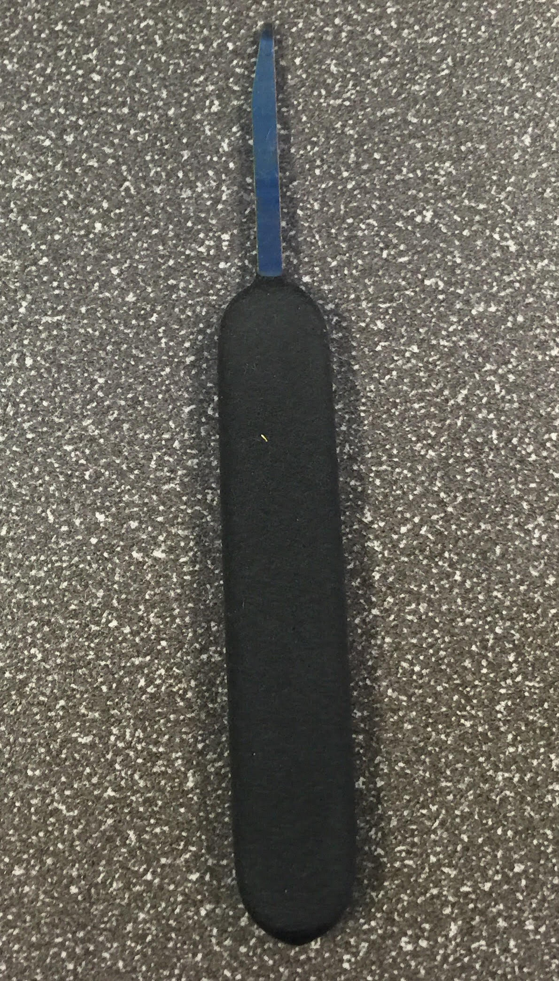
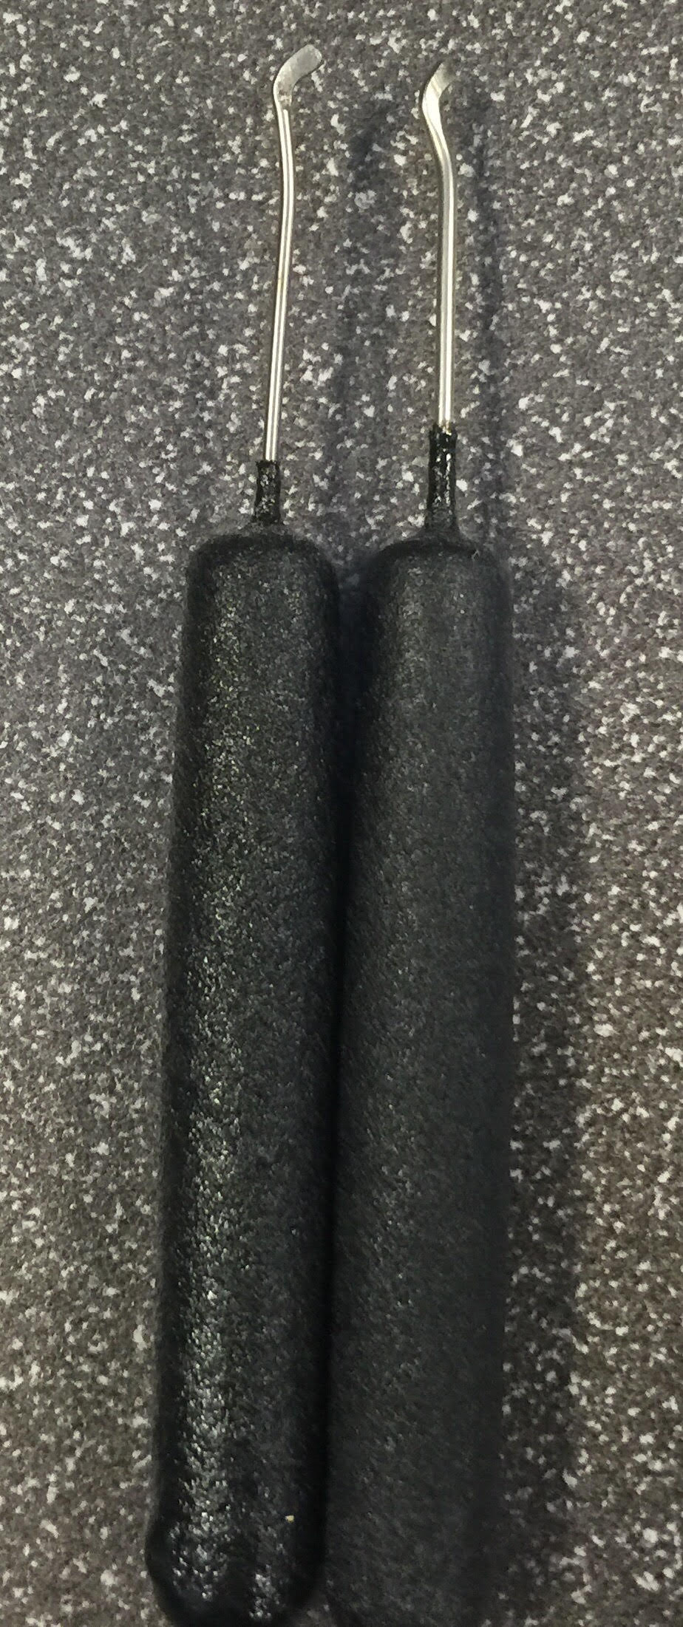
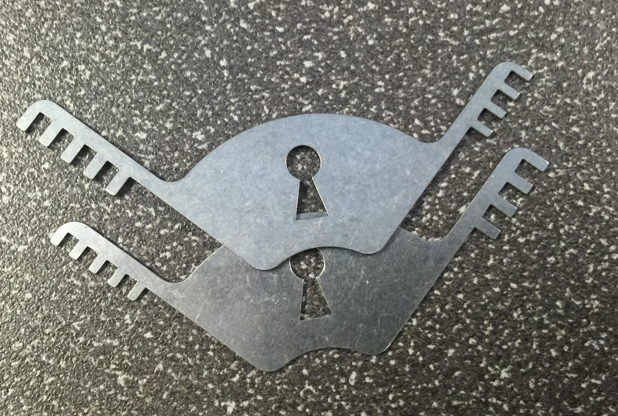
Lock Bypasses pt 2
Comb picks. Bypasses most 40-50mm padlocks
Adam’s Rite and American Padlocks bypass
Ultra Decoder (Master 175 bypass)

Slide 35
Any questions?
Take some time to play with the locks and I’ll be here to answer any questions for you.
Thank you for watching!

